Slide 1
Data aggregation

Slide 2
Data Aggregation
Data Aggregation is a process in which information is gathered and expressed in a summary form, for purposes such as statistical analysis.
A common aggregation purpose is to get more information about particular groups based on specific variables.
For E.g. Raw data can be aggregated over a given time period to provide statistics such as average, minimum, maximum, sum and count.
After the data is aggregated and written to a view or report you can analyse the aggregated data to gain insights about particular resources or resource groups.

Slide 3
Types of data aggregation
There are two types of data aggregation, Time aggregation and spatial aggregation.
Time Aggregation: all data points for a single resource over a specified time period.
Spatial Aggregation: all data points for a group of resource over a specified time period.

Slide 4
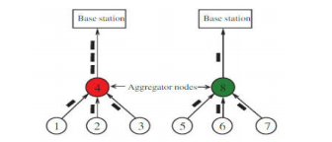

Slide 5
Above represents the models one with data aggregation and other without data aggregation.
In these the 1,2,3,5,6,7 nodes are called periodic sensor nodes that assemble data from the environment and send them to the upper nodes.
The upper two nodes are called the relay nodes or the aggregator perform the aggregation of the collected data packets by the children nodes.
In the non-data aggregation model node 4 send all the three data packets (1,2,3) to the base station.
But in second model that is with data aggregation only one data packet is transmitted by the aggregation node 8 to the base station.
Hence in IoT networks using data aggregation method we can reduce the number of data burden before they are transmitted to the base station.

Slide 6
Purpose of data aggregation
The fundamental purpose of the data aggregation strategy is to aggregate and collect the data packets in an effective manner in order to improve the energy consumption, network lifetime, traffic bottleneck, and data accuracy.
In addition, eliminating redundancy and decreasing the amount of transferred data will save the energy.
Data aggregation efficiency depends on the network design and the size of sensing data.
Because the size of sensing data is large, it is forced to reduce the top communication in the network.

Slide 7
Advantages
Generally, data aggregation methods offer several advantages as follows:
It helps to improve the efficiency and accuracy of information, which is achieved via a whole network
Specific redundancy exists in the data gathered from nodes, so this process is required to decrease the unnecessary information
Also, it decreases the traffic load and saves energy of the nodes

Slide 8
Motivation of using data aggregation
One of the chief motivations of utilizing data aggregation schemes in low-power and lossy networks (LLNs) and IoT is to decrease energy consumption and increase network lifetime .
Since each network node not only has limited capacity to generate, process, and save data; but it is also responsible for data exchange of its neighbor nodes; the necessity of efficient utilization of network resources is axiomatic.

Slide 9
Goal of data aggregation
The bulk of information continuously generated by IoT necessitates the conversion of aggregated data into intelligence. Such an intelligent environment can play a vital role in data routing of networks
Coverage, sensing, connection, and communication of each node in IoT requires energy and cost expenditures.
As IoT equipment is becoming more and more portable and smaller, the energy limitation of such equipment is a significant and challenging issue to be addressed Thus, prolonging the lifetime of network nodes in order to provide long term monitoring is considered as one of the staple goals of myriads of IoT protocols
On the other hand, as the rate of the generated and transmitted data toward the base station of the network is remarkably significant, the data aggregation procedure in IoT nodes is also costly.
The primary goal of data aggregation methods is to collect and classify data packets in an acceptably efficient manner in terms of energy consumption rate, network lifetime, traffic bottleneck, and data purity .
The type and approach of the employed data aggregation method varies based on the topology type, communication type, network design, and data generation rate

Slide 10
In data aggregation procedure, if the central nodes do not perform accurately, the base station will not be able to provide an accurate estimation of the received data; all of which result in the efficiency decline of the network. Hence, data aggregation approaches play an important role in monitoring purposes as well as the long term observation of the environment.

Slide 11
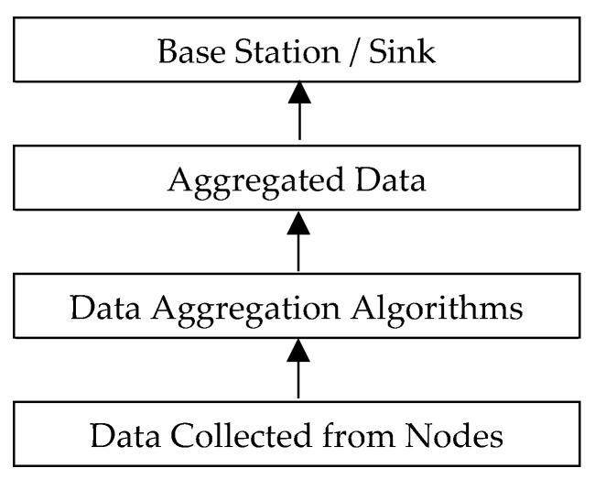
Proposed data aggregation information

Slide 12
The proposed data aggregation infrastructure has three Layers :
Data aggregation at the level of the sensors-layer 1
Data aggregation at the base station (BS)-layer 2
Data aggregation at the big data Server or NoSQL Server-layer 3 server.

Slide 13
Categories of data aggregation
three categories, including cluster-based, centralized and tree-based aggregation mechanisms for IoT:

Slide 14
Cluster-based mechanisms
Cluster-based networks can reduce the performance load in terms of reducing the aggregate computation and energy consumption of all nodes .
In cluster-based mechanisms, the network environment is divided into different clusters while each cluster comprises a number of sensor nodes.
In each cluster, one node is selected as the head of all other nodes in a cluster.
This will not only decrease the number of transmitted packets, but it also reduces the transmission overhead and bandwidth consumption in transmissions from the cluster to a base station .
For each head node a data storage system is presented, which has an efficient functionality in terms of security, scalability, flexibility, and reliability in IoT to be used in the procedure of enormous data analysis.

Slide 15
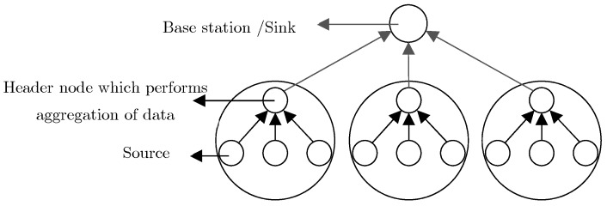

Slide 16
Centralized mechanisms
Another suggested data aggregation method in IoT is termed as the centralized method .
In this method, the data existing in all other network nodes along a route is transmitted to only one node.
In other words, all nodes deliver their sensed information to a single node, which is superior to other network nodes in terms of hardware features and resources
In this method, the central node generally aggregates several data packets and converts them into a single packet .
In this approach, while the unity of data is conserved, confidentiality and accessibility of the network are taken into consideration as well.
The main challenge of this mechanism is the low accessibility of the central node in the network. Also, data will be lost if breaks occur in the central node .

Slide 17
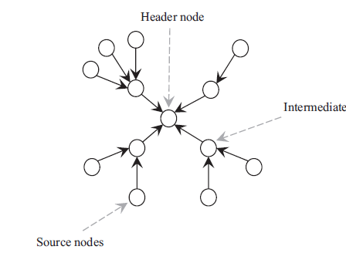

Slide 18
Tree-based mechanisms
Another structure of IoT topology is based on trees.
In this structure, tree construction is initiated from the root node (i.e., sink node), and proceeds hierarchically to reach leaf nodes located at the final level.
After the formation of network tree, leaf nodes and median nodes start sensing the parameters associated with the application type.
Afterward, through the accessible parent, each node begins exchanging and transmitting data to the root node.
Nodes placed between the root node and the leaf node act as the collector of the transmitted packets from its children.
One of the main goals of the tree-based structure in LLN networks and multi-hop wireless networks is to conserve energy as well as reducing the hidden terminal effect in the network, in that by utilizing multi-hop communication, an acceptable balance is established in energy consumption rate .
The offered mechanism decreases the necessary data rates, network traffic, and extends system lifetime.

Slide 19
